Slide 1
Statistics For Economics (HS20204) – Lecture 1 INTRODUCTION TO DESCRIPTIVE STATISTICS

Slide 2
What is Statistics?
Statistics is the science of collection, presentation, analysis, and reasonable interpretation of data.

Slide 3
Types of Data
Based on collection – methodology:
Primary
Secondary
Based on time & space
Cross – sectional
Time Series
Panel

Slide 4
Statistical Description of Data
Statistics describes a numeric set of data by its:
Central Tendency
Variability / Dispersion
Shape (Skewness & Kurtosis)
Statistics describes a categorical set of data by:
Frequency, percentage or proportion of each category

Slide 5
Measures of Central Tendency
Mean:
i. Arithmetic Mean (A.M)
ii. Geometric Mean(G.M)
iii. Harmonic Mean(H.M)
Median
Mode

Slide 6
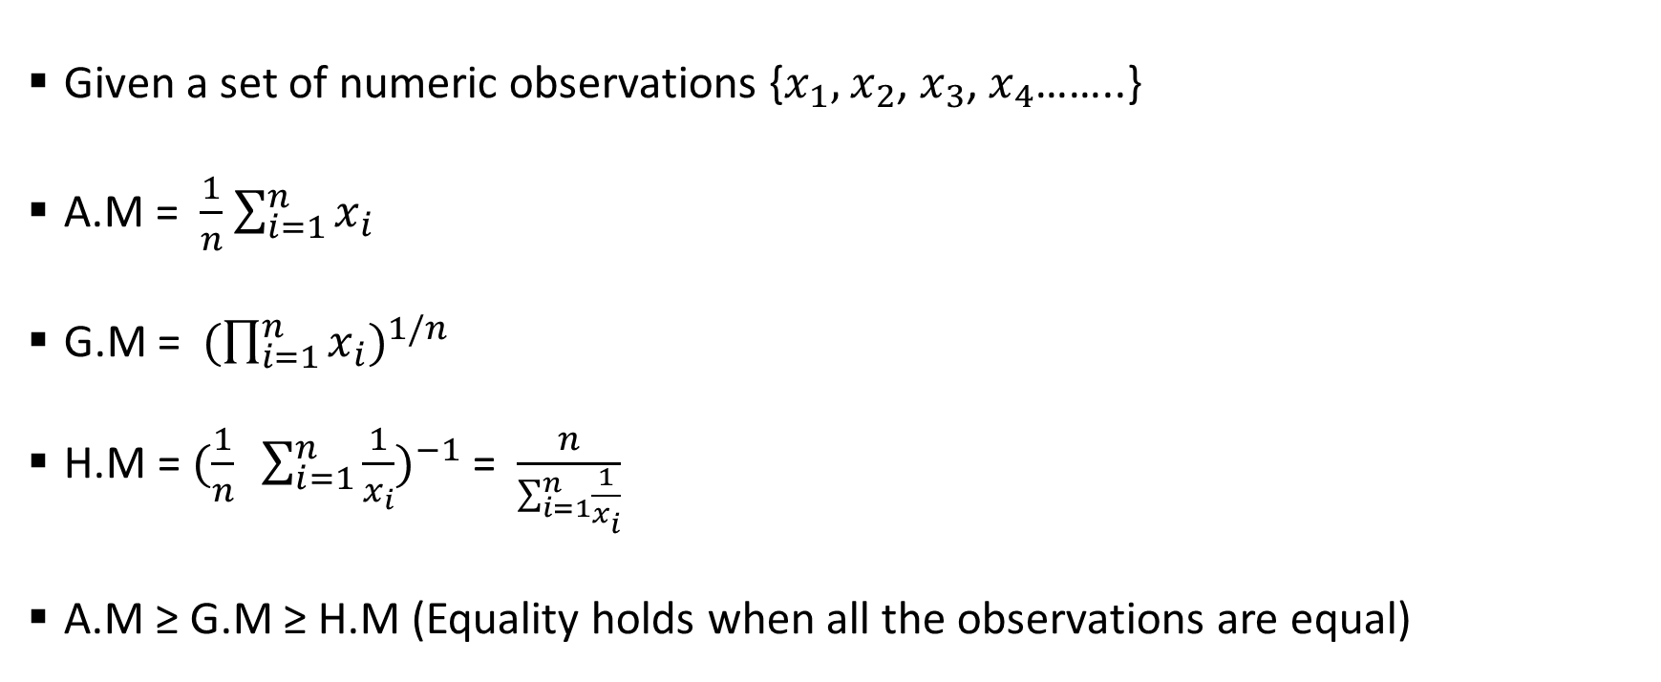
Mean
Given a set of numeric observations {$x_{1},$ $x_{2}$, $x_{3}$, $x_{4}$……..}
A.M = $\frac{1}{n}$ $\sum_{i=1}^{n}{x_{i}}$
G.M = ${(\prod_{i=1}^{n}{x_{i}})}^{1/n}$
H.M = ${(\frac{1}{n} \sum_{i=1}^{n}{\frac{1}{x_{i}}})}^{−1}$ = $\frac{n}{\sum_{i=1}^{n}{\frac{1}{x_{i}}}}$
A.M ≥ G.M ≥ H.M (Equality holds when all the observations are equal)

Slide 7
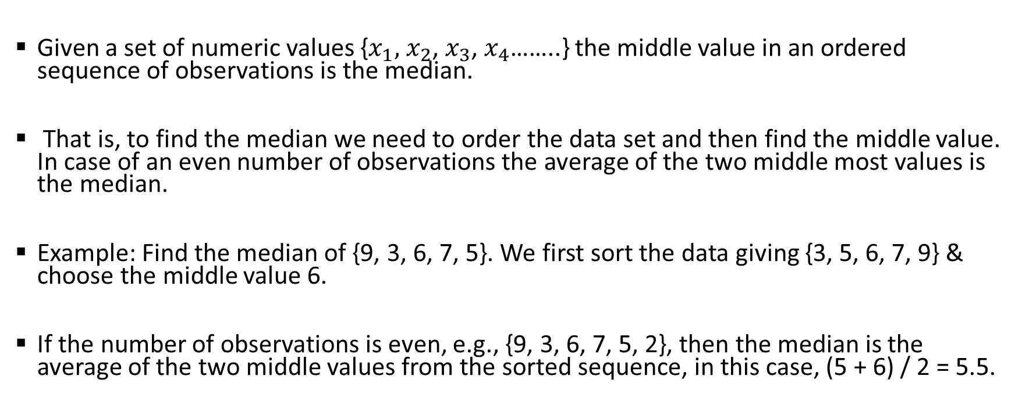
Median
Given a set of numeric values {$x_{1},$ $x_{2}$, $x_{3}$, $x_{4}$……..} the middle value in an ordered sequence of observations is the median.
That is, to find the median we need to order the data set and then find the middle value. In case of an even number of observations the average of the two middle most values is the median.
Example: Find the median of {9, 3, 6, 7, 5}. We first sort the data giving {3, 5, 6, 7, 9} & choose the middle value 6.
If the number of observations is even, e.g., {9, 3, 6, 7, 5, 2}, then the median is the average of the two middle values from the sorted sequence, in this case, (5 + 6) / 2 = 5.5.

Slide 8
Mode
The value that is observed most frequently. The mode is undefined for sequences in which no observation is repeated.
Consider the set numbers {1,2,6,6,7,8,7,7,9,9,0,1}. Here clearly the most occurring number is 7. So the mode of this set of observations is = 7.

Slide 9
Mean vs Median
The median is less sensitive to outliers (extreme scores) than the mean and thus a better measure than the mean for highly skewed distributions, e.g. family income.
For example mean of 20, 30, 40, and 990 is (20+30+40+990)/4 =270. The median of these four observations is (30+40)/2 =35.
Here 3 observations out of 4 lie between 20-40. So, the mean 270 really fails to give a realistic picture of the major part of the data. It is influenced by extreme value 990.

Slide 10
Variability / Dispersion
Variability (or dispersion) measures the amount of scatter in a dataset.
Common measures:
Range
Variance / standard deviation
interquartile range
coefficient of variation etc.

Slide 11
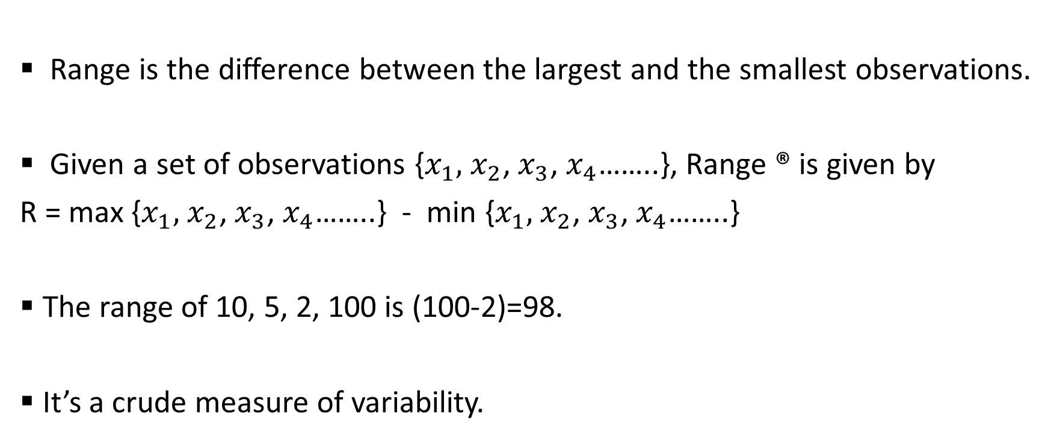
Range
Range is the difference between the largest and the smallest observations.
Given a set of observations {$x_{1},$ $x_{2}$, $x_{3}$, $x_{4}$……..}, Range ® is given by
R = max {$x_{1},$ $x_{2}$, $x_{3}$, $x_{4}$……..} - min {$x_{1},$ $x_{2}$, $x_{3}$, $x_{4}$……..}
The range of 10, 5, 2, 100 is (100-2)=98.
It’s a crude measure of variability.

Slide 12

Standard Deviation
Given a set of numeric observations {$x_{1},$ $x_{2}$, $x_{3}$, $x_{4}$……..}
Variance (V) = $\frac{1}{n}\sum_{i=1}^{n}{{(x_{i}−\overline{x})}^{2}}$
Standard deviation (s.d) = $\sqrt{V}$

Slide 13
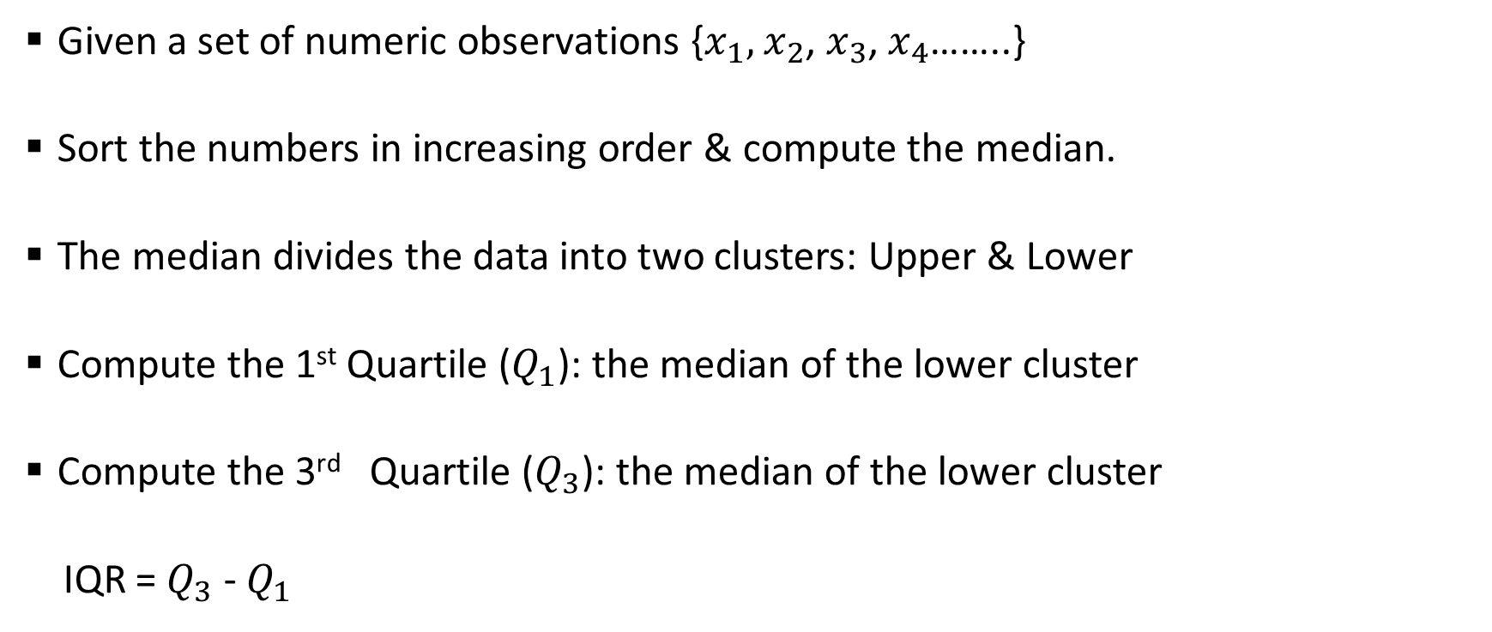
Inter – Quartile Range (IQR)
Given a set of numeric observations {$x_{1},$ $x_{2}$, $x_{3}$, $x_{4}$……..}
Sort the numbers in increasing order & compute the median.
The median divides the data into two clusters: Upper & Lower
Compute the 1st Quartile ($Q_{1}$): the median of the lower cluster
Compute the 3rd Quartile ($Q_{3}$): the median of the lower cluster
IQR = $Q_{3}$ - $Q_{1}$

Slide 14
IQR - Example
Consider the following set of numbers {1, 3, 4, 5, 5, 6, 7, 11}.
Q1 is the middle value in the first half of the data set i.e {1, 3, 4, 5}
Since there are an even number of data points in the first half of the data set, the middle value is the average of the two middle values; that is, Q1 = (3 + 4)/2 = 3.5.
Q3 is the middle value in the second half of the data set i.e {5, 6, 7, 11}
Again, since the second half of the data set has an even number of observations, the middle value is the average of the two middle values; that is, Q3 = (6 + 7)/2 = 6.5.
The interquartile range is Q3 minus Q1, so IQR = 6.5 - 3.5 = 3.

Slide 15
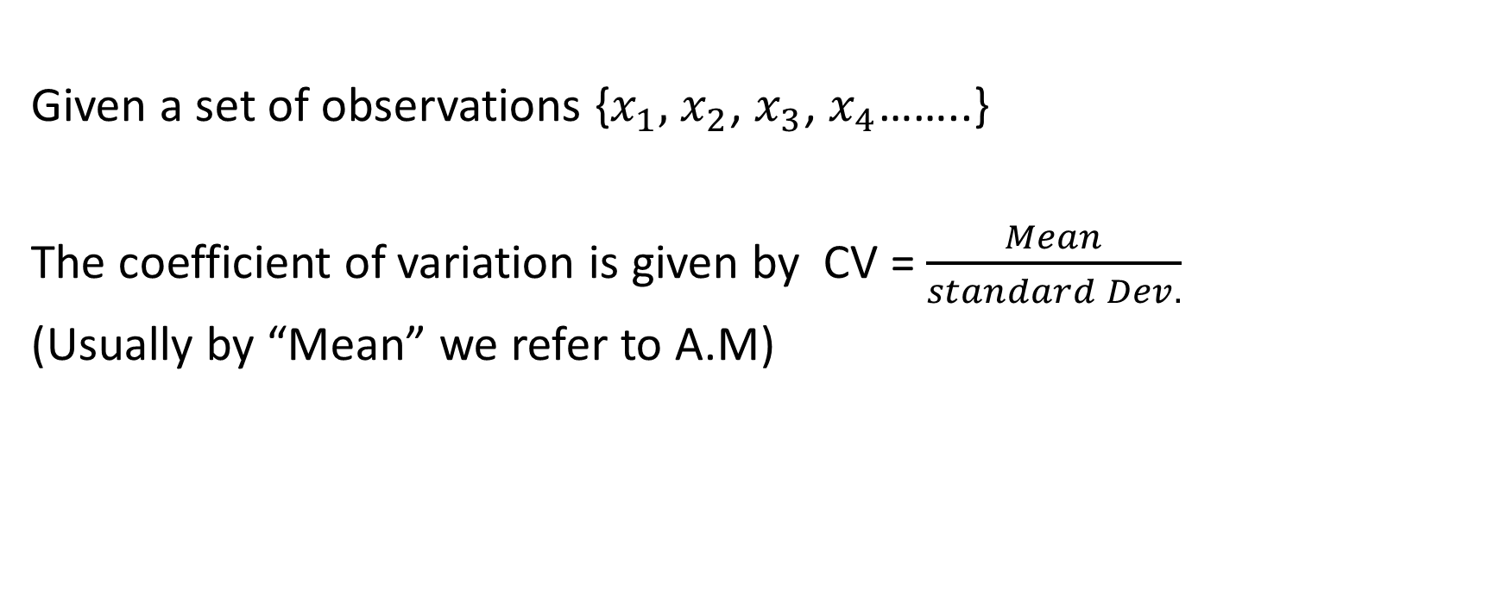
Coefficient of Variation
Given a set of observations {$x_{1},$ $x_{2}$, $x_{3}$, $x_{4}$……..}
The coefficient of variation is given by CV = $\frac{Mean}{standard Dev.}$
(Usually by “Mean” we refer to A.M)

Slide 16
Frequency Distribution
In this type of classification there are two elements
Variable: Variable refers to the characteristic that varies in magnitude or quantity. E.g. weight of the students.
Frequency: Frequency refers to the number of times each variable gets repeated. For example there are 50 students having weight of 60 kgs. Here 50 students is the frequency.
There are two types of quantitative classification of data:
Discrete frequency distribution (the variable is discrete)
Continuous frequency distribution (the variable is continuous)

Slide 17
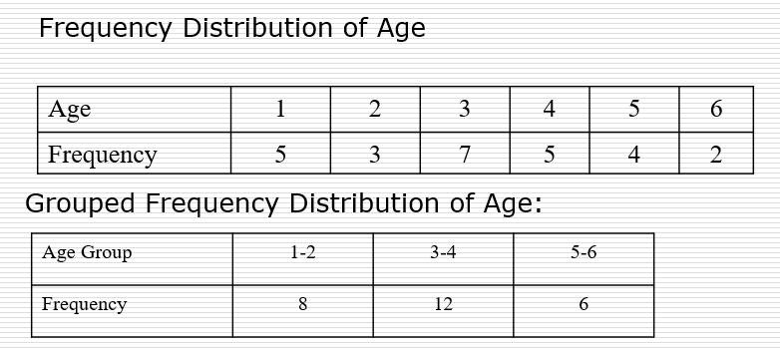
Frequency Distribution - Example
Consider a data set of 26 children of ages 1-6 years. Then the frequency distribution of variable ‘age’ can be tabulated as follows:

Slide 18
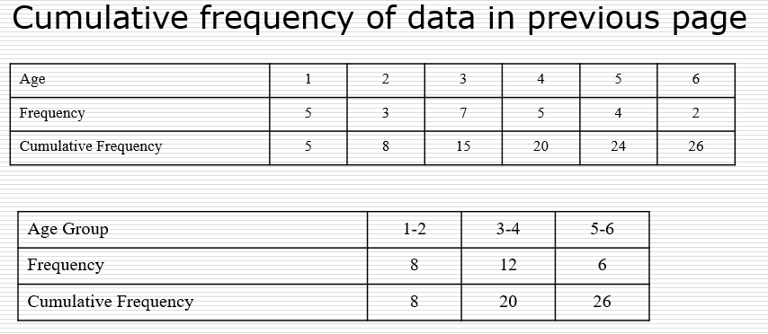
Cumulative Frequency Distribution

Slide 19
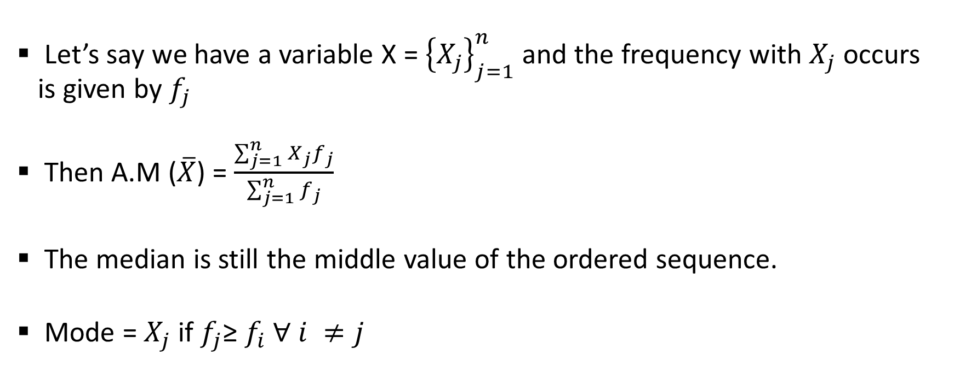
Central Tendency (of a freq. dist.)
Let’s say we have a variable X = ${\left\{X_{j}\right\}}_{j=1}^{n}$and the frequency with $X_{j}$ occurs is given by $f_{j}$
Then A.M ($\overline{X}$) = $\frac{\sum_{j=1}^{n}{X_{j}f_{j}}}{\sum_{j=1}^{n}{f_{j}}}$
The median is still the middle value of the ordered sequence.
Mode = $X_{j}$ if $f_{j}$≥ $f_{i}$ $∀ i ≠j$

Slide 20
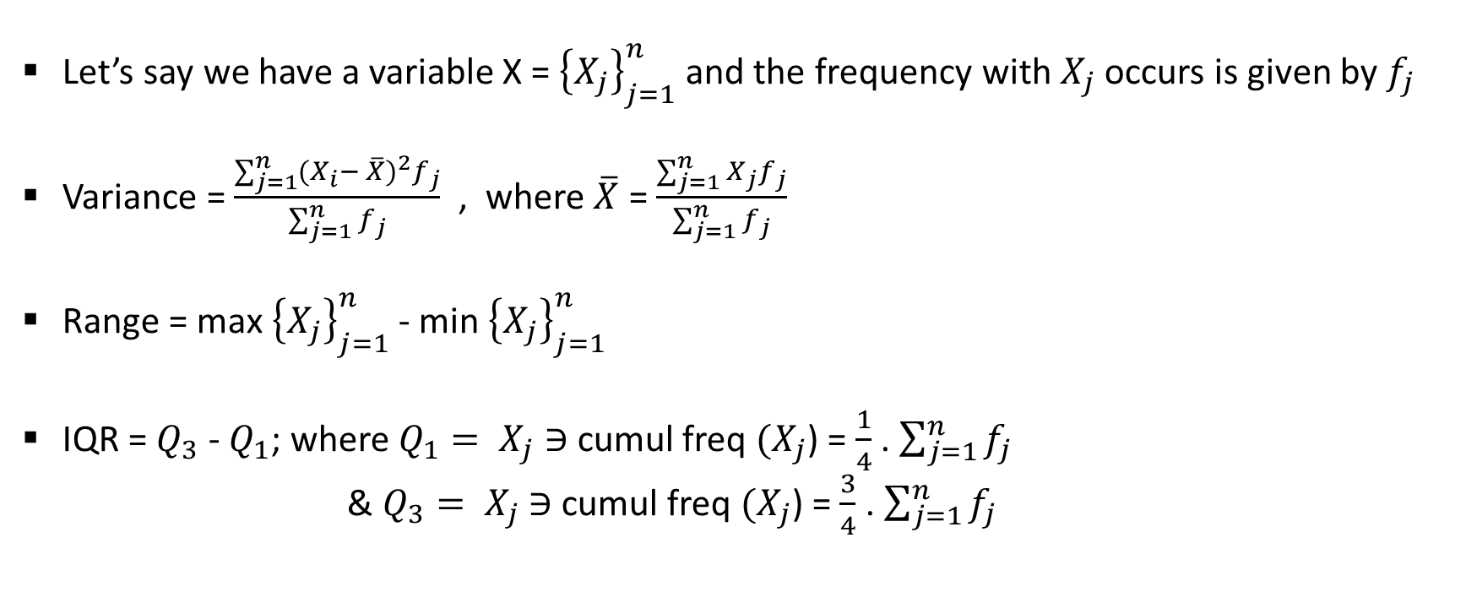
Dispersion (of a freq. dist.)
Let’s say we have a variable X = ${\left\{X_{j}\right\}}_{j=1}^{n}$and the frequency with $X_{j}$ occurs is given by $f_{j}$
Variance = $\frac{\sum_{j=1}^{n}{{(X_{i}− \overline{X})}^{2}f_{j}}}{\sum_{j=1}^{n}{f_{j}}}$ , where $\overline{X}$ = $\frac{\sum_{j=1}^{n}{X_{j}f_{j}}}{\sum_{j=1}^{n}{f_{j}}}$
Range = max ${\left\{X_{j}\right\}}_{j=1}^{n}$ - min ${\left\{X_{j}\right\}}_{j=1}^{n}$
IQR = $Q_{3}$ - $Q_{1}$; where $Q_{1}= X_{j}$ $∋$cumul freq $(X_{j}$) = $\frac{1}{4}$ . $\sum_{j=1}^{n}{f_{j}}$
& $Q_{3}= X_{j}$ $∋$cumul freq $(X_{j}$) = $\frac{3}{4}$ . $\sum_{j=1}^{n}{f_{j}}$

Slide 21
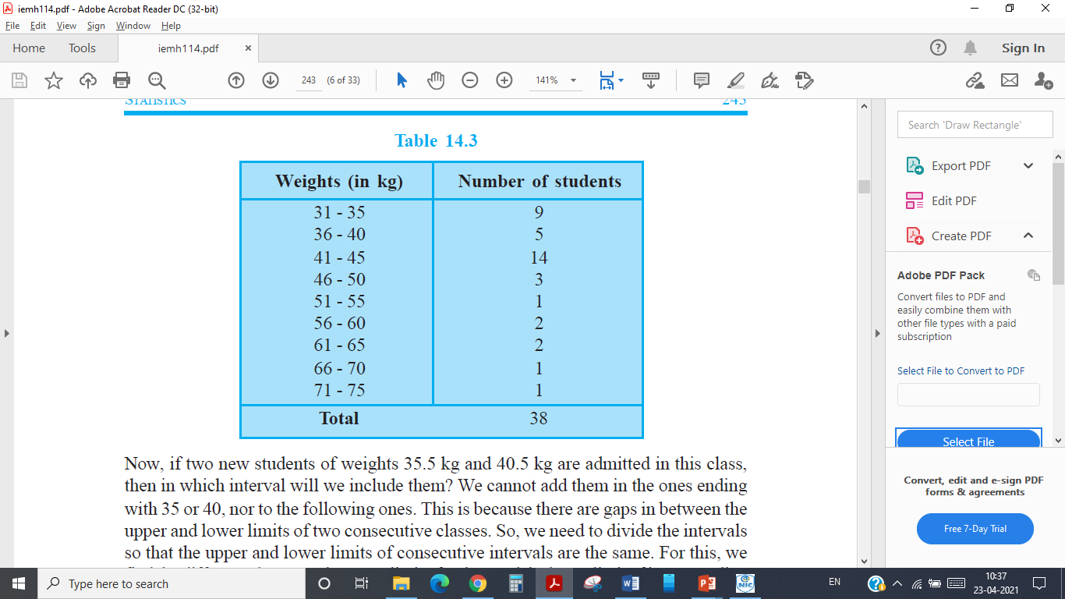
Continuous Frequency distribution
The following technical terms are important when a continuous frequency distribution is formed
Class limits: Class limits are the lowest and highest values that can be included in a class. For example take the class 51-55. The lowest value of the class is 51 and the highest value is 55. In this class there can be no value lesser than 51 or more than 55. 51 is the lower class limit and 55 is the upper class limit.
Class interval: The difference between the upper and lower limit of a class is known as class interval of that class.
Class frequency: The number of observations corresponding to a particular class is known as the frequency of that class

Slide 22
Shape (Skewness & Kurtosis)

Slide 23
Concept of Skewness
A frequency distribution is said to be skewed-when the mean, median and mode fall at different position in the distribution and the balance (or center of gravity) is shifted to one side or the other i.e. to the left or to the right.
Therefore, the concept of skewness helps us to understand the relationship between three measures-
Mean.
Median.
Mode.

Slide 24
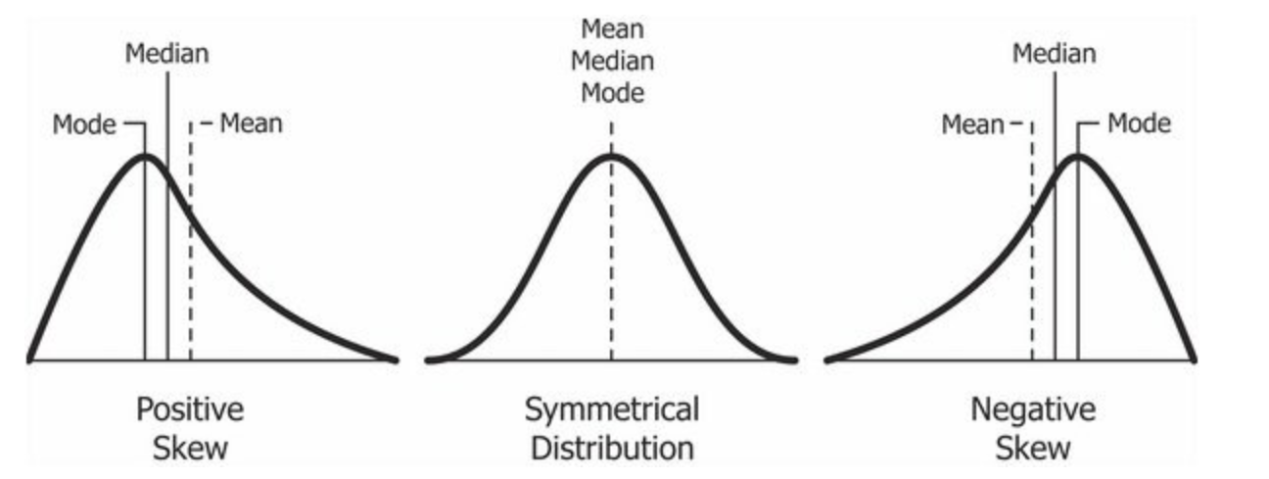
Symmetrical Distribution
A frequency distribution is said to be symmetrical if the frequencies are equally distributed on both the sides of central value.
A symmetrical distribution may be either bell – shaped or U shaped.
In symmetrical distribution, the values of mean, median and mode are equal i.e. Mean=Median=Mode

Slide 25
Skewed Distribution
A frequency distribution is said to be skewed if the frequencies are not equally distributed on both the sides of the central value.
A skewed distribution may be-
Positively Skewed
Negatively Skewed

Slide 26
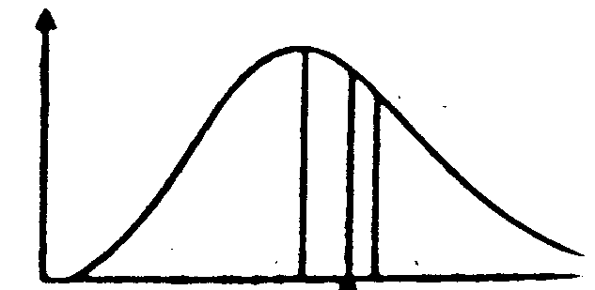
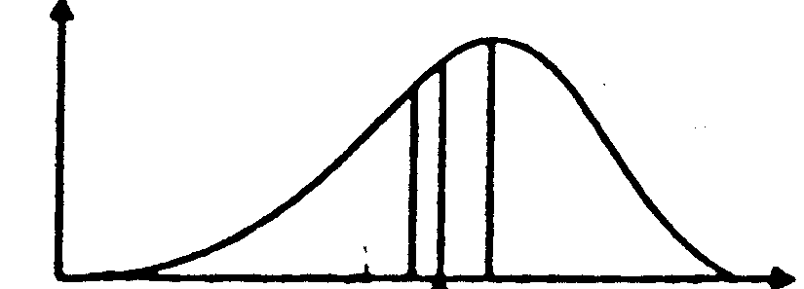
Skewed Distribution
Negatively Skewed
In this, the distribution is skewed to the left (negative)
Here, Mode exceeds Mean and Median.
Positively Skewed
In this, the distribution is skewed to the right (positive)
Here, Mean exceeds Mode and Median.
Mean<Median<Mode
Mode<Median<Mean
Notes:
Mean = 64; Median =64.8 and Mode= 65.2....... Negatively Skewed
Mean>Median>Mode.... Positively skewed

Slide 27
Tests of Skewness
In order to ascertain whether a distribution is skewed or not the following tests may be applied. Skewness is present if:
The values of mean, median and mode do not coincide.
When the data are plotted on a graph they do not give the normal bell shaped form i.e. when cut along a vertical line through the center the two halves are not equal.
The sum of the positive deviations from the median is not equal to the sum of the negative deviations.
Quartiles are not equidistant from the median.
Frequencies are not equally distributed at points of equal deviation from the mode.

Slide 28
Graphical Measures of Skewness
Measures of skewness help us to know to what degree and in which direction (positive or negative) the frequency distribution has a departure from symmetry.
Positive or negative skewness can be detected graphically (as below) depending on whether the right tail or the left tail is longer but, we don’t get idea of the magnitude
Hence some statistical measures are required to find the magnitude of lack of symmetry
Mean> Median> Mode
Mean=Median=Mode
Mean<Median<Mode
Symmetrical
Skewed to the Left
Skewed to the Right

Slide 29
Statistical Measures of Skewness
Absolute Measures of Skewness
Relative Measures of Skewness
Following are the absolute measures of skewness:
Skewness (Sk) = Mean – Median
Skewness (Sk) = Mean – Mode
Skewness (Sk) = (Q3 - Q2) - (Q2 - Q1)
There are four measures of skewness:
β and γ Coefficient of skewness
Karl Pearson's Coefficient of skewness
Bowley’s Coefficient of skewness
Kelly’s Coefficient of skewness

Slide 30
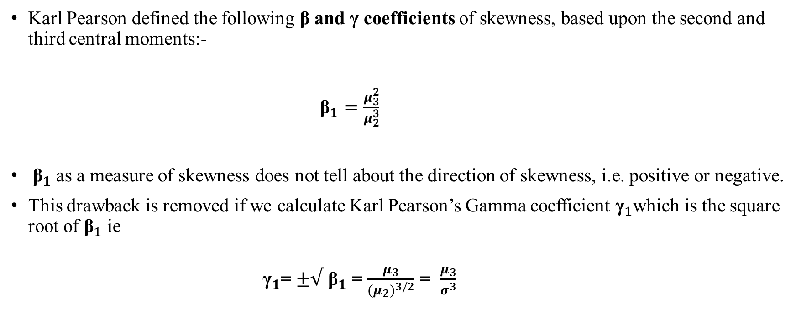
β and γ Coefficient of Skewness

Slide 31
Karl Pearson's Coefficient of Skewness……01
This method is most frequently used for measuring skewness. The formula for measuring coefficient of skewness is given by
SK_{P} =
Mean – Mode
σ
Where,
SK_{P} = Karl Pearson's Coefficient of skewness,
σ = standard deviation.
Normally, this coefficient of skewness lies between -3 to +3.
Notes:
Mode = 3 Median – 2 Mean

Slide 32
Karl Pearson's Coefficient of Skewness…..02
In case the mode is indeterminate, the coefficient of skewness is:
Mean – (3 Median - 2 Mean)
σ
SK_{P} =
Now this formula is equal to
3(Mean - Median) σ
SK_{P}
=
The value of coefficient of skewness is zero, when the distribution is symmetrical.
The value of coefficient of skewness is positive, when the distribution is positively skewed.
The value of coefficient of skewness is negative, when the distribution is negatively skewed.
Notes:
If Sk = + or – 3: Perfectly Positively/Negatively Skewed. If Sk = +/- 2 to 2.99 : High degree Positive/Negative skewness
If Sk = +/- 1 to 1.99 : Moderate degree Positive/Negative skewness; If Sk = +/- 0.1 to 0.99 : Low degree Positive/Negative skewness

Slide 33
Bowley’s Coefficient of Skewness……01
Bowley developed a measure of skewness, which is based on quartile values.
The formula for measuring skewness is:
(Q₃ – Q₂) – (Q₂ – Q₁) (Q₃ – Q₁)
SK_{B} =
Where,
SK_{B} = Bowley’s Coefficient of skewness,
Q₁ = Quartile first Q₂ = Quartile second
Q₃ = Quartile Third

Slide 34
Bowley’s Coefficient of Skewness…..02
The above formula can be converted to-
SK_{B} =
Q₃ + Q₁ – 2Median (Q₃ – Q₁)
The value of coefficient of skewness is zero, if it is a symmetrical distribution.
If the value is greater than zero, it is positively skewed distribution.
And if the value is less than zero, it is negatively skewed distribution.

Slide 35
Kelly’s Coefficient of Skewness…..01
Kelly developed another measure of skewness, which is based on percentiles and deciles.
The formula for measuring skewness is based on percentile as follows:
P₉₀ – 2P₅₀ +
^{P}90 ^{– P}10
^{P}10
SK_{k} =
Where,
SK_{K} = Kelly’s Coefficient of skewness,
^{P}90 ^{P}50 ^{P}10
= Percentile Ninety.
= Percentile Fifty.
= Percentile Ten.

Slide 36
Kelly’s Coefficient of Skewness…..02
This formula for measuring skewness is based on percentile are as follows:
SK_{k} =
D₉ – 2D₅ + D₁ D₉ – D₁
Where,
SK_{K} = Kelly’s Coefficient of skewness,
D₉ = Deciles Nine.
D₅ = Deciles Five. D₁ = Deciles one.

Slide 37
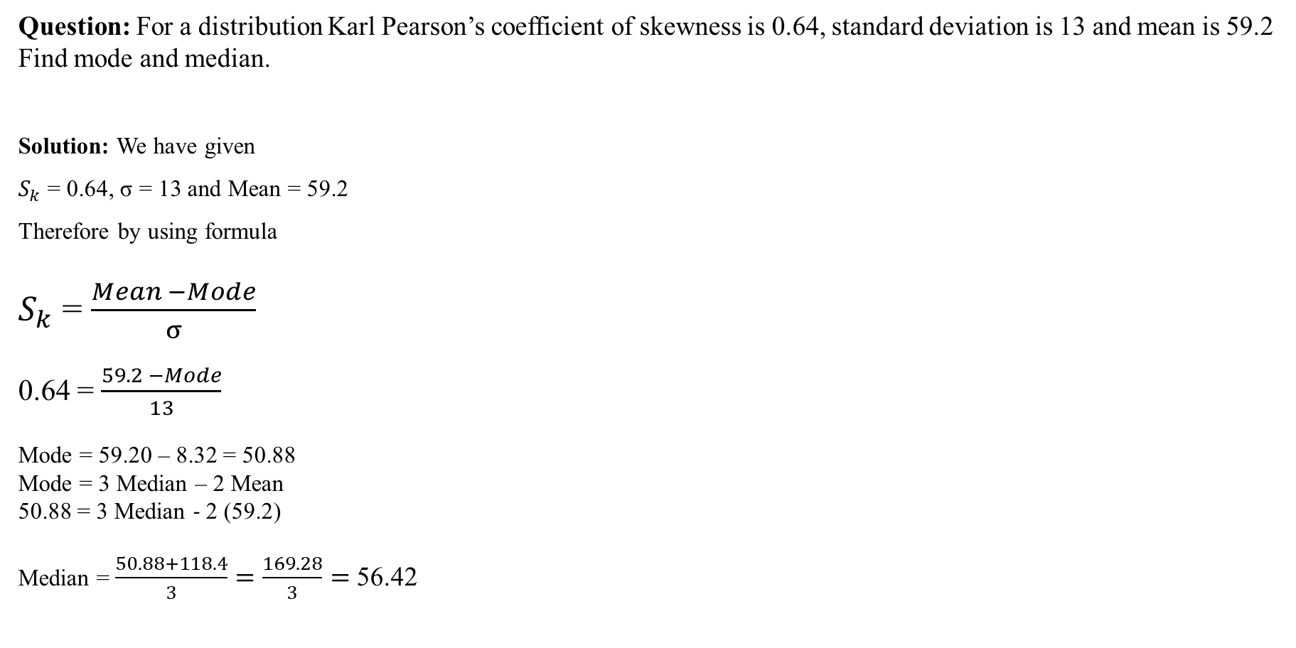
Example:

Slide 38
Homework:
Ques: The following are the marks of 150 students in an examination. Calculate Karl Pearson’s coefficient of skewness.
Marks | No. of Students
0-10 | 20
10-20 | 10
20-30 | 40
30-40 | 0
40-50 | 15
50-60 | 20
60-70 | 15
70-80 | 10
80-90 | 30

Slide 39
Moments:
In Statistics, moments is used to indicate peculiarities of a frequency distribution.
The utility of moments lies in the sense that they indicate different aspects of a given distribution.
Thus, by using moments, we can measure the central tendency of a series, dispersion or variability, skewness and the peakedness of the curve.
The moments about the actual arithmetic mean are denoted by μ.
The first four moments about mean or central moments are following:-

Slide 40
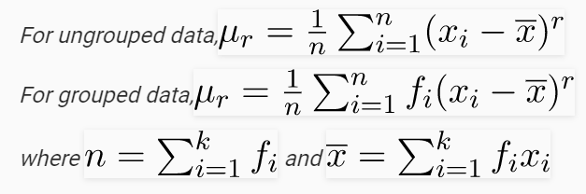
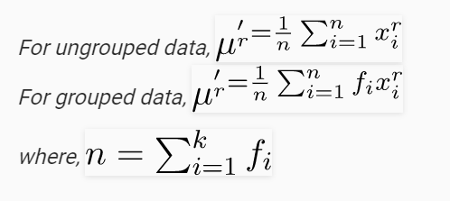
Moments:
Moments around Mean
Moments around any Arbitrary No

Slide 41
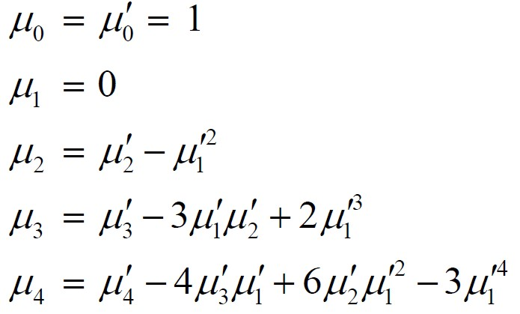
Conversion formula for Moments
(Mean)
1st moment:
2nd moment:
3rd moment:
4th moment:
(Variance)
(Skewness)
(Kurtosis)

Slide 42
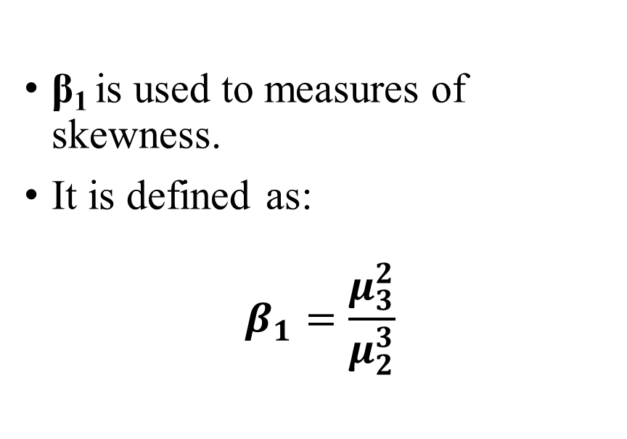
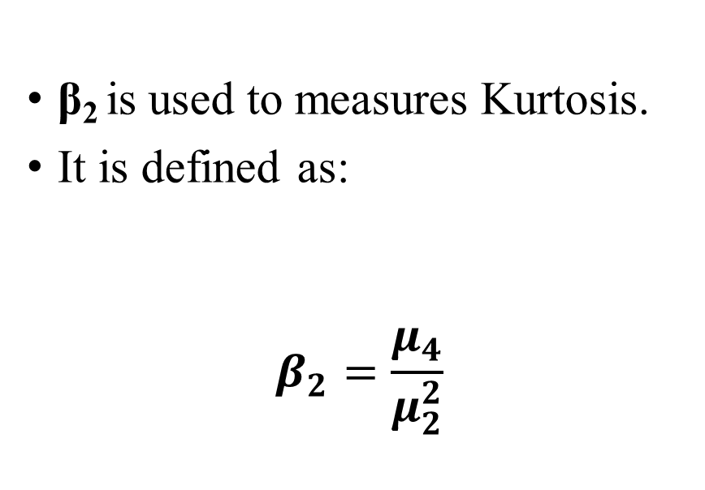
Two important constants calculated from μ_{2,} μ₃ and μ₄ are:-
β₁ (read as beta one)
β₂ (read as beta two)

Slide 43
Kurtosis
Kurtosis is another measure of the shape of a frequency curve. It is a Greek word, which means bulginess.
While skewness signifies the extent of asymmetry, kurtosis measures the degree of peaked-ness of a frequency distribution.
Karl Pearson classified curves into three types on the basis of the shape of their peaks. These are:-
Leptokurtic
Mesokurtic
Platykurtic

Slide 44
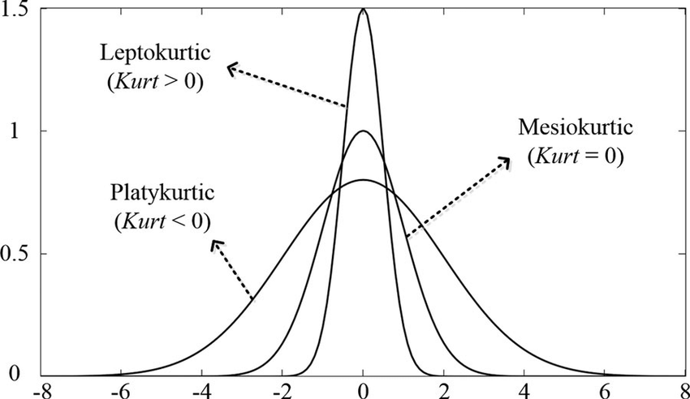
Kurtosis
When the peak of a curve becomes relatively high then that curve is called Leptokurtic.
When the curve is flat-topped, then it is called Platykurtic.
Since normal curve is neither very peaked nor very flat topped, so it is taken as a basis for comparison.
This normal curve is called Mesokurtic.

Slide 45
Measure of Kurtosis
There are two measure of Kurtosis:
Karl Pearson’s Measures of Kurtosis
Kelly’s Measure of Kurtosis

Slide 46
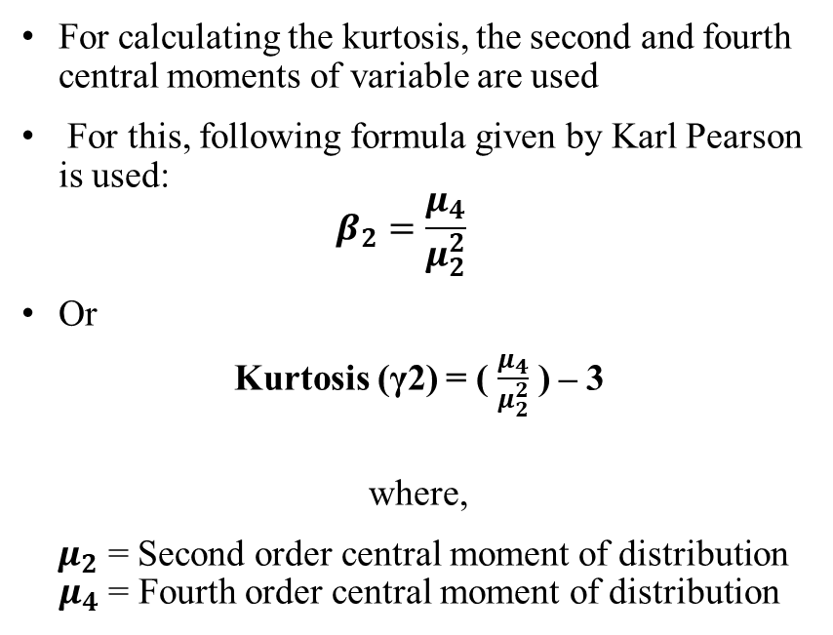
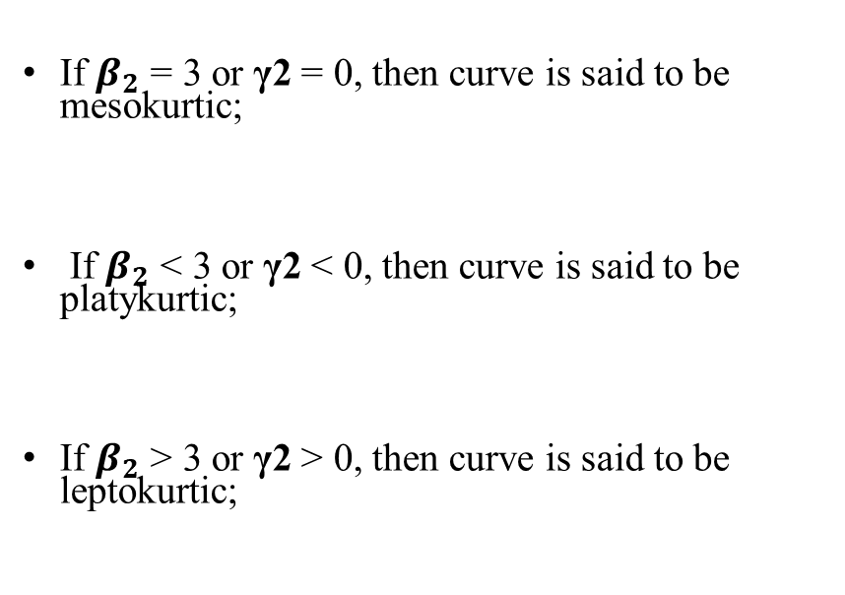
Karl Pearson’s Measures of Kurtosis
Formula
Result:

Slide 47
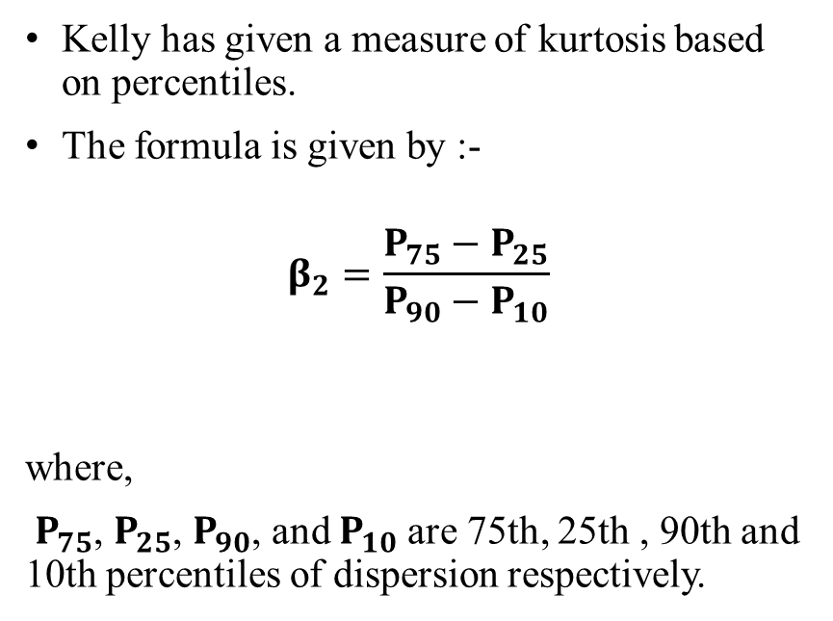
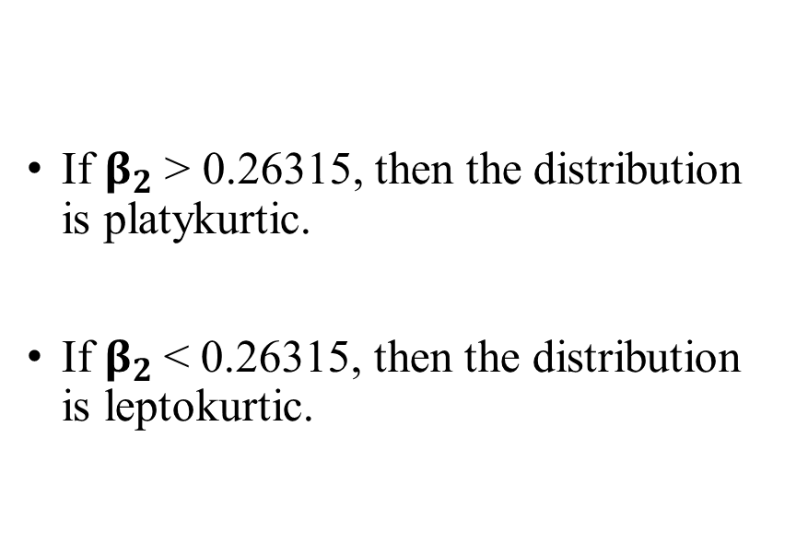
Kelly’s Measure of Kurtosis
Formula
Result:

Slide 48
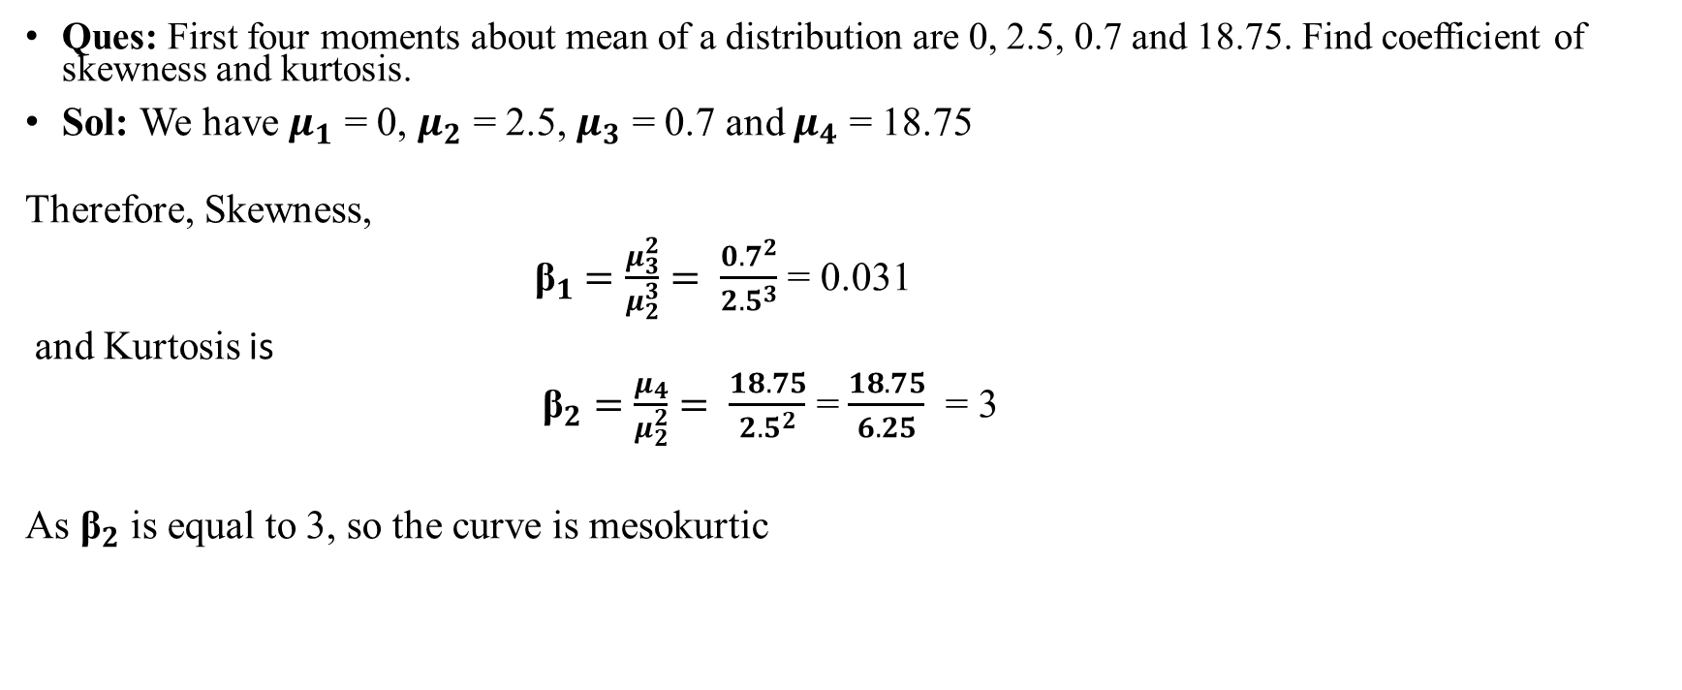
Example:

Slide 49
Homework:
Ques: The first four raw moments of a distribution are 2, 136, 320, and 40,000. Find out coefficients of skewness and kurtosis.

Slide 50
Bivariate Descriptive Statistics

Slide 51
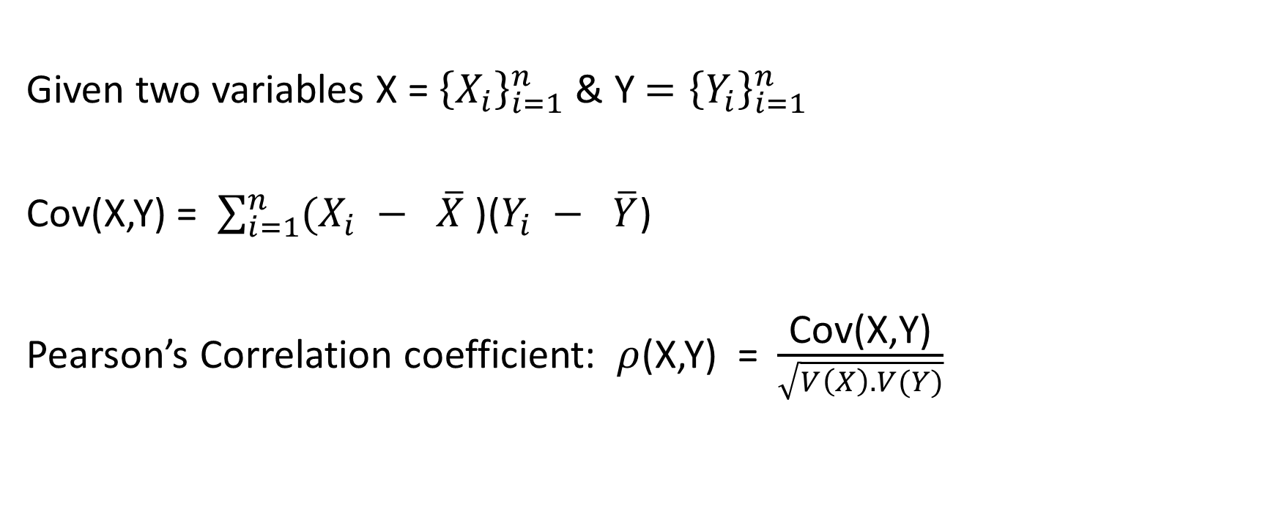
Covariance & Correlation
Given two variables X = ${\left\{X_{i}\right\}}_{i=1}^{n}$ & Y ${=\left\{Y_{i}\right\}}_{i=1}^{n}$
Cov(X,Y) = $\sum_{i=1}^{n}{(X_{i} − \overline{X}}$ )($Y_{i} − \overline{Y}$)
Pearson’s Correlation coefficient: $ρ$(X,Y) = $\frac{\text{Cov}\text{(}\text{X}\text{,}\text{Y}\text{)}}{\sqrt{V\left(X\right). V(Y)}}$

Slide 52
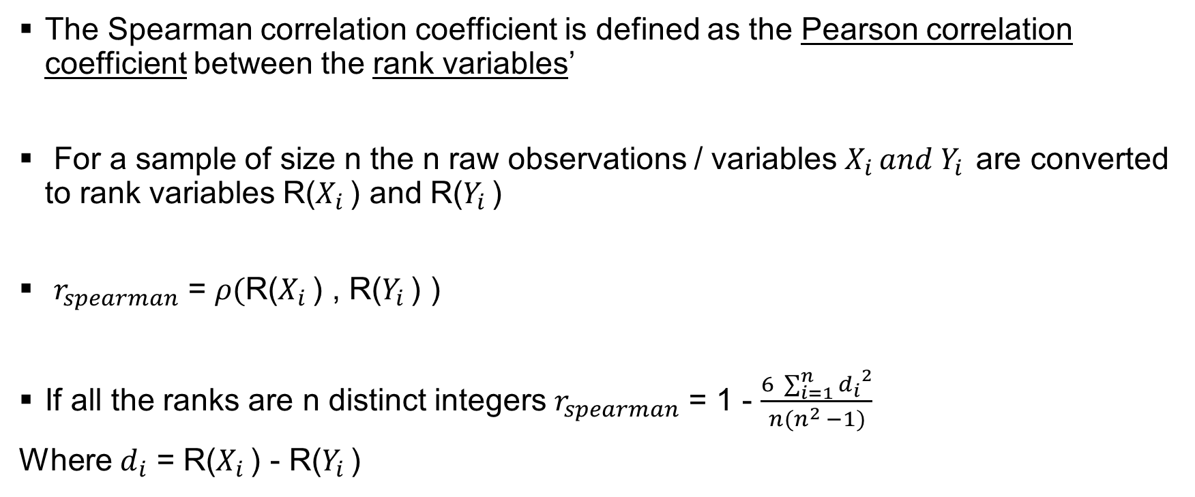
Spearman’s Rank Correlation Coefficient
The Spearman correlation coefficient is defined as the Pearson correlation coefficient between the rank variables’
For a sample of size n the n raw observations / variables $X_{i }and Y_{i }$are converted to rank variables R($X_{i }$) and R($Y_{i }$)
$r_{spearman}$ = $ρ($R($X_{i }$) , R($Y_{i }$) )
If all the ranks are n distinct integers $r_{spearman}$ = 1 - $\frac{6 \sum_{i=1}^{n}{{d_{i}}^{2}}}{n(n^{2} −1)}$
Where $d_{i}$ = R($X_{i }$) - R($Y_{i }$)

Slide 53
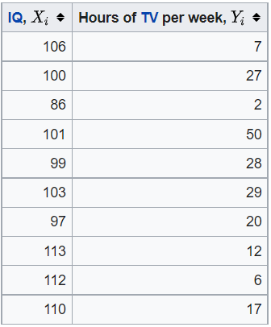
Example
In this example, the raw data in the table below is used to calculate the correlation between the IQ of a person with the number of hours spent in front of TV per week.

Slide 54
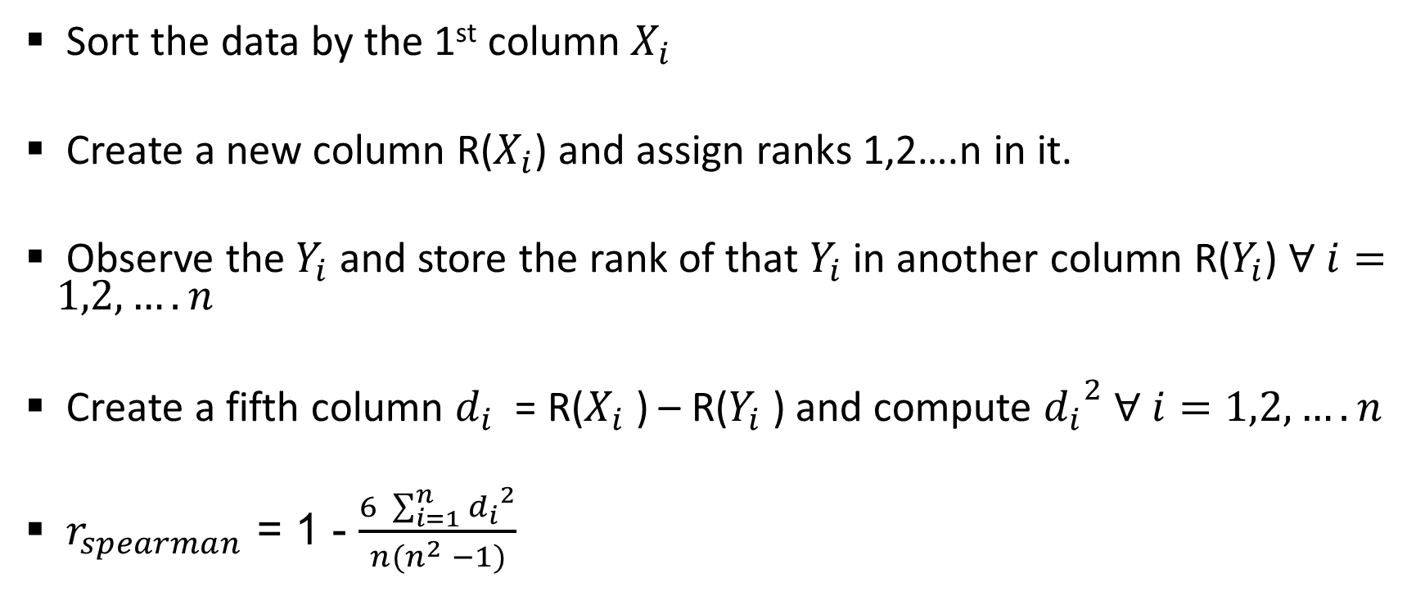
The Steps
Sort the data by the 1st column $X_{i}$
Create a new column R($X_{i}$) and assign ranks 1,2….n in it.
Observe the $Y_{i}$ and store the rank of that $Y_{i}$ in another column R($Y_{i}$) $∀ i=1,2,….n$
Create a fifth column $d_{i}$ = R($X_{i}$ ) – R($Y_{i}$ ) and compute ${d_{i}}^{2}$ $∀ i=1,2,….n$
$r_{spearman}$ = 1 - $\frac{6 \sum_{i=1}^{n}{{d_{i}}^{2}}}{n(n^{2} −1)}$

Slide 55
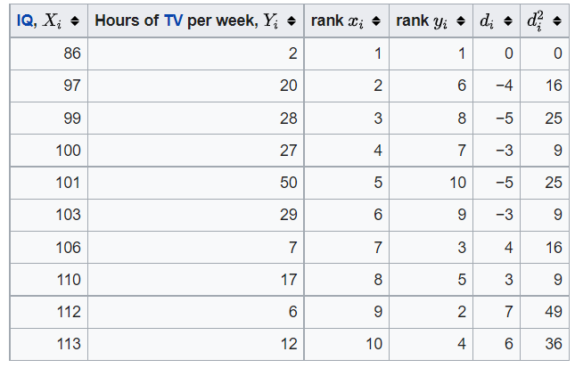

Slide 56

$\sum{{d_{i}}^{2}}$ = 194
n = 10
$r_{spearman}$ = 1 - $\frac{6 \sum_{i=1}^{n}{{d_{i}}^{2}}}{n(n^{2} −1)}$ = 1 - $\frac{6 ∗194}{10 ({10}^{2}−1)}$ = - 0.175

Slide 57
Measures of Inequality

Slide 58
Setup
Society has n individuals.
Index i stands for a generic individual, i = 1, 2, . . . , n.
An income distribution is a description of how much income y is received by individual i : (y₁, y₂, . . . , y_{n}).
Compare relative “inequality” of two income distributions.

Slide 59
Anonymity Principle
It does not matter who earns the income. Anonymity because we care about the ordering but not the identity of each earner.
All that matters is the ranking from lowest to highest:
y₁, y₂, . . . , y_{n} → y₍₁₎, y₍₂₎, · · · , y_{(n)}
ordered statistic ^{y}(1) ^{≤ y}(2) ^{≤ y}(3) ^{≤ · · · ≤ y}(n)

Slide 60
Population Principle
If we compare an income distribution over n people and another population with 2n people with the same income pattern repeated twice, there should be no difference in inequality among the two income distributions.
Anonymity states that no information is lost by retaining only the sequence of individual incomes (and not the identities of each)
The population principle states it doesn’t matter how large the population is, we can convert everything to percentiles (bottom 1%, lowest 20%, top 25%)

Slide 61
Relative Income Principle
Only the relative incomes should matter and the absolute levels of these incomes should not.
Thus if we transform one distribution by multiply by a positive constant (e.g., Y ¹ = λY ⁰) then inequality should be the same for the two distributions.
Income levels have no meaning for inequality measurement. Absolute measure matters for assessing economic development. We will see that level matters for the measurement of poverty.
Roughly think of poverty as a measure of location (level) and inequality as a measure of dispersion.

Slide 62
Dalton’s Principle
This is fundamental to the construction of inequality measures.
Let (y₁, y₂, . . . , y_{n}) be an income distribution and consider two incomes y_{i} and y_{j} with y_{i} ≤ y_{j} .
A transfer of income from individual i to individual j is called a regressive transfer.
If inequalities is strict y_{i} < y_{j} the regressive transfer is from the poorer individual to the richer individual.
With weak inequality (≤) use the language “not richer” to “not poorer”

Slide 63
Our inequality index as a function of the form: I = I (y₁, y₂, . . . , y_{n}) with I defined over all conceivable distributions of income (y₁, y₂, . . . , y_{n}).
Dalton principle: if one income distribution can be achieved from another by constructing a sequence of regressive transfers, then the former distribution must be deemed more unequal than the latter.
If for every income distribution (y₁, y₂, . . . , y_{n}) and every transfer
δ > 0, I (y₁, . . . , y_{i} , . . . , y_{j} , . . . , y_{n}) < I (y₁, . . . , y_{i} − δ, . . . , y_{j} + δ, . . . , y_{n})

Slide 64
Lorenz Curve
Lorenz curve is a simple diagrammatic way to depict the distribution of income.
On the horizon axis we list the cumulative percentage of the population arranged in increasing order of income.
Thus point A on the axis refer to the poorest 20% of the population, the poorest half, etc.
On the vertical axis we measure the percentage of the national income accruing to any particular fraction of the population thus arranged.
The diagonal line (45◦) represents equal distribution income.

Slide 65
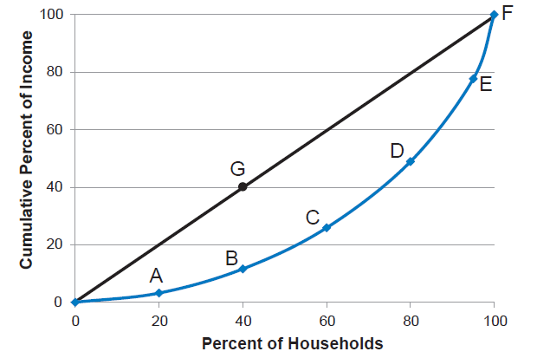
Lorenz Curve for the United States
Source: U.S. Census Bureau, Historical Income Tables, Households, Table H-2.
Notes:
A Lorenz curve shows the cumulative amount of all income obtained by different percentiles of households, ordered from those with the lowest incomes to those with the highest incomes.

Slide 66
Lorenz Curve Properties
The slope of the Lorenz curve is the contribution of the person at that point to the cumulative share of national income.
Ordered from poorest to richest the “marginal contribution” can never fall.
Equivalently, the Lorenz curve can never get flatter as we move from left to right.
The overall distance between the 45◦ and the Lorenz curve represents the amount of inequality present in the society.

Slide 67
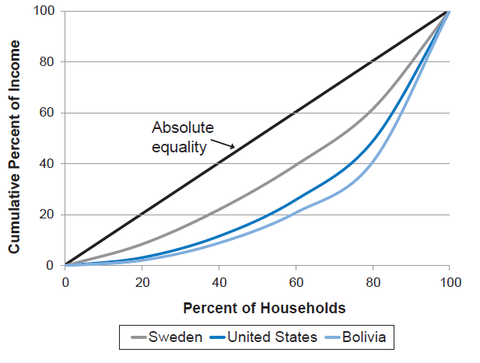
Lorenz Curves for Sweden, the United States, and Bolivia
Sources: Statistics Sweden, online database, Disposable Income in Deciles 2011–2014; U.S. Census Bureau, Historical Income Tables, Households, Table H-2; World Bank, World Development Indicators database.
Notes:
The closer the Lorenz curve is to the line of absolute equality, the lower the degree of economic inequality.

Slide 68
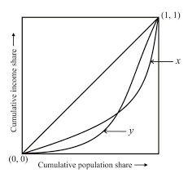
Intersecting Lorenz Curve – Confusion !
Notes:
The closer the Lorenz curve is to the line of absolute equality, the lower the degree of economic inequality.

Slide 69
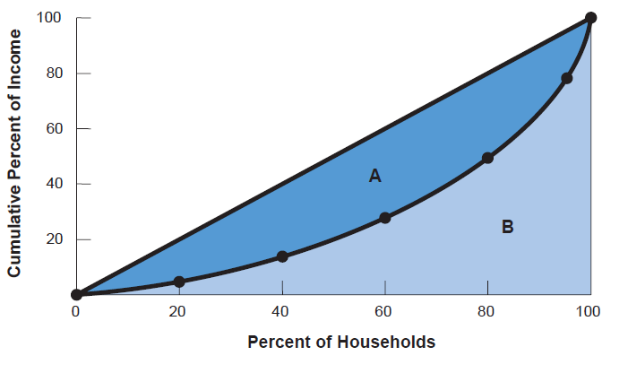
The Gini Coefficient: A/(A+B)
Notes:
The larger area A is, the greater the deviation from absolute equality, and thus the higher the Gini coefficient.

Slide 70
Data and Trends

Slide 71
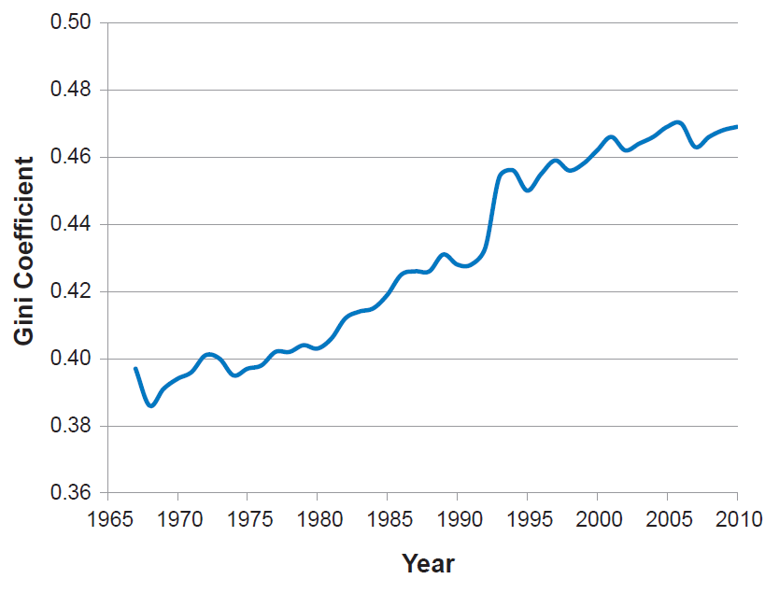
Figure 10.4: Gini Coefficient in the United States, 1967-2010
Source: U.S. Census Bureau, Historical Income Tables, Households, Table H-2.
Notes:
Since the late 1960s income inequality in the United States has tended to increase.

Slide 72
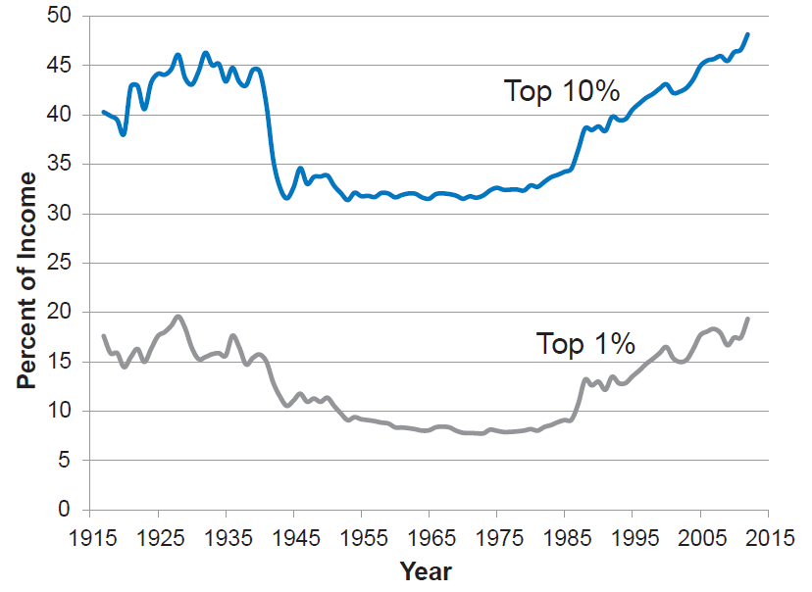
Figure 10.5: Income Share of the Top 10 Percent and Top 1 percent in the United States, 1917-2012
Source: Emmanuel Saez, income inequality database updated to 2012, University of California, Berkeley, http://elsa.berkeley.edu/~saez/.
Notes:
The share of income going the highest income groups generally decreased from the Great Depression until the early 1970s. Since then, the share of income going to the top groups has increased, reaching levels even higher than those prior to the Great Depression.

Slide 73
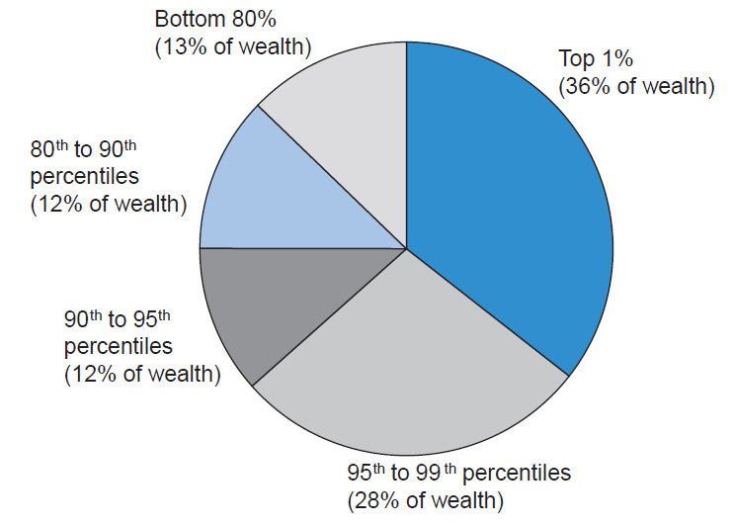
Figure 10.6: The Distribution of Wealth in the United States, 2009
Source: Sylvia A. Allegretto, “The State of Working America’s Wealth, 2011,” Economic Policy Institute, EPI Briefing Paper #292, March 23, 2011.
Notes:
The top 1 percent owns over one-third of wealth in the United States and the top 20 percent own 87 percent of wealth. The bottom 80 percent own only 13 percent of wealth.

